Slide 1
Address Space Management
Transitioning
to IPv6

Slide 2
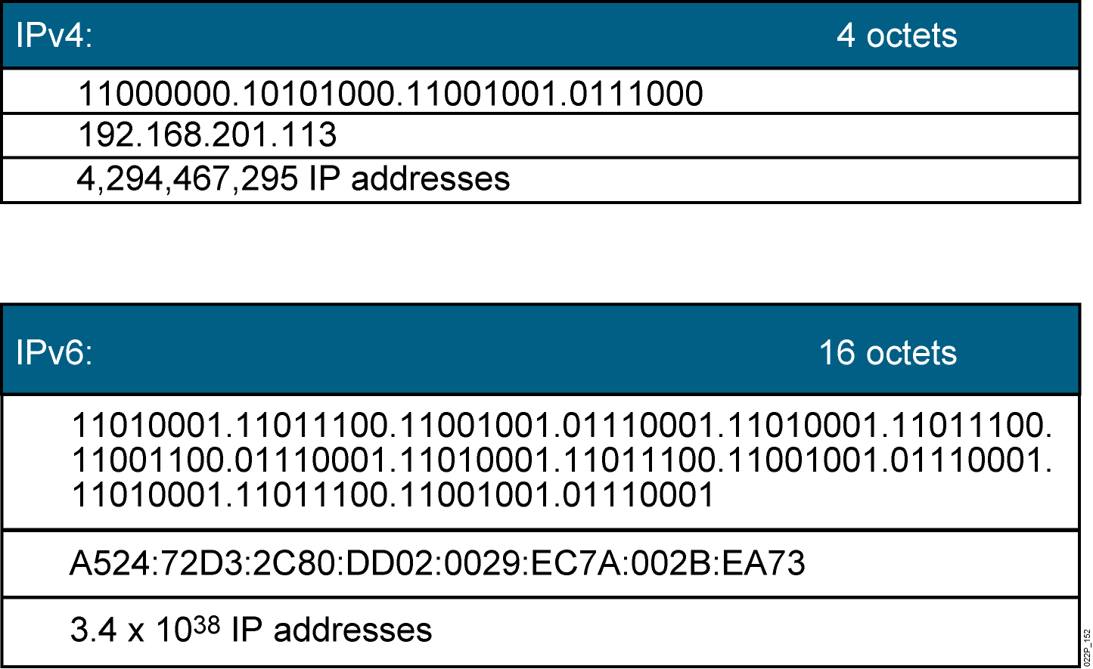
IPv4 and IPv6
Currently, there are approximately 1.3 billion usable IPv4 addresses
available.
Notes:
Lesson Aim
<Enter lesson aim here.>

Slide 3
Why Do We Need a Larger
Address Space?
  Internet population
    Approximately 973 million users in November 2005
    Emerging population and geopolitical address space
  Mobile users
    PDA, pen tablet, notepad, and so on
    Approximately 20 million in 2004
  Mobile phones
    Already 1 billion mobile phones delivered by the industry
  Transportation
    1 billion automobiles forecast for 2008
    Internet access in planes, for example, Lufthansa
  Consumer devices
    Sony mandated that all its products be IPv6-enabled by 2005
    Billions of home and industrial appliances

Slide 4
IPv6 Advanced Features
Larger address space:
  Global reachability and flexibility
  Aggregation
  Multihoming
  Autoconfiguration
  Plug-and-play
  End-to-end without NAT
  Renumbering
Mobility and security:
  Mobile IP RFC-compliant
  IPsec mandatory (or native)
  for IPv6
Simpler header:
  Routing efficiency
  Performance and forwarding rate scalability
  No broadcasts
  No checksums
  Extension headers
  Flow labels
Transition richness:
  Dual stack
  6to4 and manual tunnels
  Translation

Slide 5
IPv6 Address Representation
Format:
  x:x:x:x:x:x:x:x, where x is a 16-bit hexadecimal field
    Case-insensitive for hexadecimal A, B, C, D, E, and F
  Leading zeros in a field are optional
  Successive fields of zeros can be represented as :: only once per address
Examples:
  2031:0000:130F:0000:0000:09C0:876A:130B
    Can be represented as 2031:0:130f::9c0:876a:130b
    Cannot be represented as 2031::130f::9c0:876a:130b
  FF01:0:0:0:0:0:0:1 FF01::1
  0:0:0:0:0:0:0:1 ::1
  0:0:0:0:0:0:0:0 ::

Slide 6
IPv6 Address Types
  Unicast:
    Address is for a single interface
    IPv6 has several types (for example, global, reserved, link-local, and site-local)
  Multicast:
    One-to-many
    Enables more efficient use of the network
    Uses a larger address range
  Anycast:
    One-to-nearest (allocated from unicast address space)
    Multiple devices share the same address
    All anycast nodes should provide uniform service
    Source devices send packets to anycast address
    Routers decide on closest device to reach that destination
    Suitable for load balancing and content delivery services

Slide 7
IPv6 Unicast Addressing
  Types of IPv6 unicast addresses:
    Global: Starts with 2000::/3 and assigned by IANA
    Reserved: Used by the IETF
    Private: Link local (starts with FE80::/10)
    Loopback (::1)
    Unspecified (::)
  A single interface may be assigned multiple IPv6 addresses of any type: unicast, anycast, or multicast.
  IPv6 addressing rules are covered by multiple RFCs.
    Architecture defined by RFC 4291

Slide 8
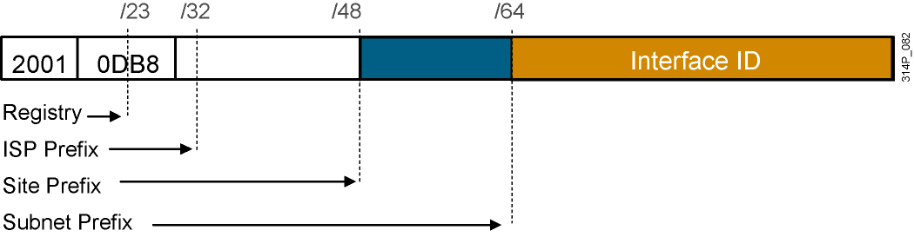
IPv6 Global Unicast (and Anycast)
Addresses
IPv6 has the same address format for global unicast and for
anycast addresses.
  Uses a global routing prefix—a structure that enables aggregation upward,
  eventually to the ISP.
  A single interface may be assigned multiple addresses of any type
  (unicast, anycast, multicast).
  Every IPv6-enabled interface contains at least one loopback (::1/128)
  and one link-local address.
  Optionally, every interface can have multiple unique local and global addresses.

Slide 9
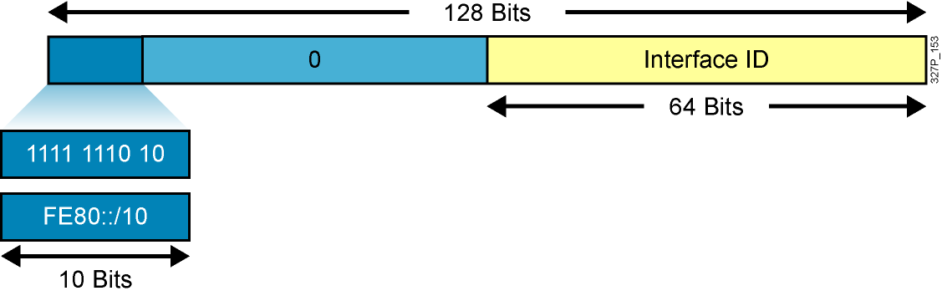
Link-Local Addresses
Link-local addresses have a scope limited to the link and are dynamically
created on all IPv6 interfaces by using a specific link-local prefix FE80::/10
and a 64-bit interface identifier.
Link-local addresses are used for automatic address configuration, neighbor
discovery, and router discovery. Link-local addresses are also used by many
routing protocols.
Link-local addresses can serve as a way to connect devices on the same local
network without needing global addresses.
When communicating with a link-local address, you must specify the outgoing
interface because every interface is connected to FE80::/10.

Slide 10
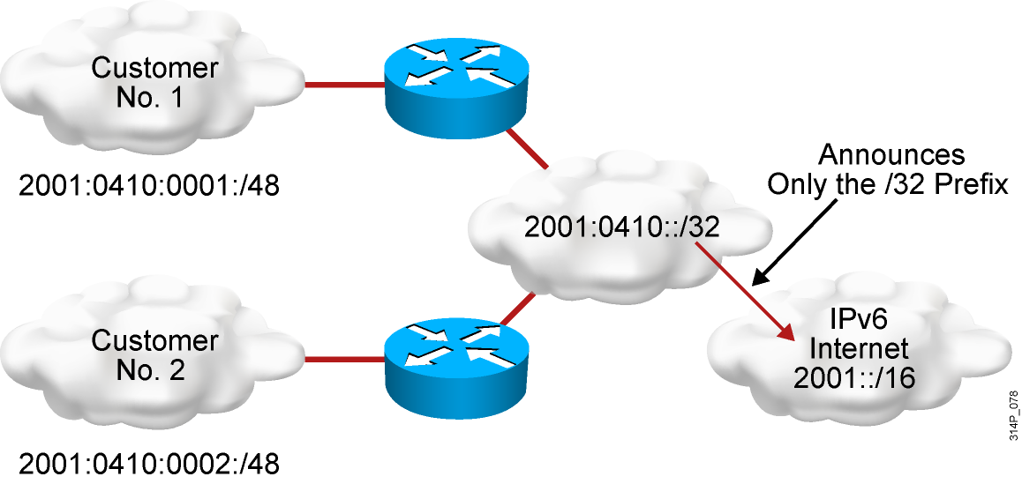
Larger Address Space Enables
Address Aggregation
Address aggregation provides the following benefits:
  Aggregation of prefixes announced in the global routing table
  Efficient and scalable routing
  Improved bandwidth and functionality for user traffic

Slide 11
Assigning IPv6 Global Unicast Addresses
  Static assignment
    Manual interface ID assignment
    EUI-64 interface ID assignment
  Dynamic assignment
    Stateless autoconfiguration
    DHCPv6 (stateful)

Slide 12
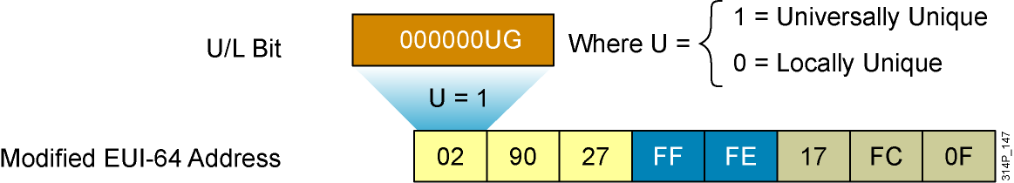
IPv6 EUI-64 Interface Identifier
Cisco can use the EUI-64 format for interface identifiers.
This format expands the 48-bit MAC address to 64 bits by
inserting “FFFE” into the middle 16 bits.
To make sure that the chosen address is from a unique
Ethernet MAC address, the U/L bit is set to 1 for global scope
(0 for local scope).
Notes:
EUI-64 to IPv6 Interface Identifier
The interface identifier for stateless auto-configuration in an Ethernet environment uses the modified EUI-64 format. This format expands the 48-bit Ethernet MAC address format to a 64-bit version by inserting "FFFE" in the middle of the 48 bits. This creates a 64-bit version.
The 7th bit (starting with the leftmost bit as “1”) in an IPv6 interface identifier is referred to as the Universal/Local bit, or U/L bit. This bit identifies whether this interface identifier is locally unique on the link or that it is universally unique. In the case where the interface identifier is created from an Ethernet MAC address, it is assumed that the MAC address is universally unique and, therefore, the interface identifier is universally unique.
The rationale of the U/L bit is for future use of the upper-layer protocols to uniquely identify a connection, even in the context of a change in the leftmost part of the address. However, this is not yet used.
The 8th bit (starting with leftmost bit as “1”), also known as the “G” bit, is a group/individual bit for managing groups.
Note to Graphic Designer:
Animation is needed for this slide.
Stage 1: Show Ethernet MAC address (top address on slide) and two FF and FE blocks.
Stage 2: Show the FF and FE blocks going in-between blocks 27 and 17 of Ethernet address. Change label of address to Ethernet MAC address (64 bits). Also Show the U/L bit coming out of the OO block with the where U = information.
Stage 3: Show final Modified EUI-64 address.
Instructor Note
Discuss the transformative process for EUI-64 to IPv6 interface identifier.

Slide 13
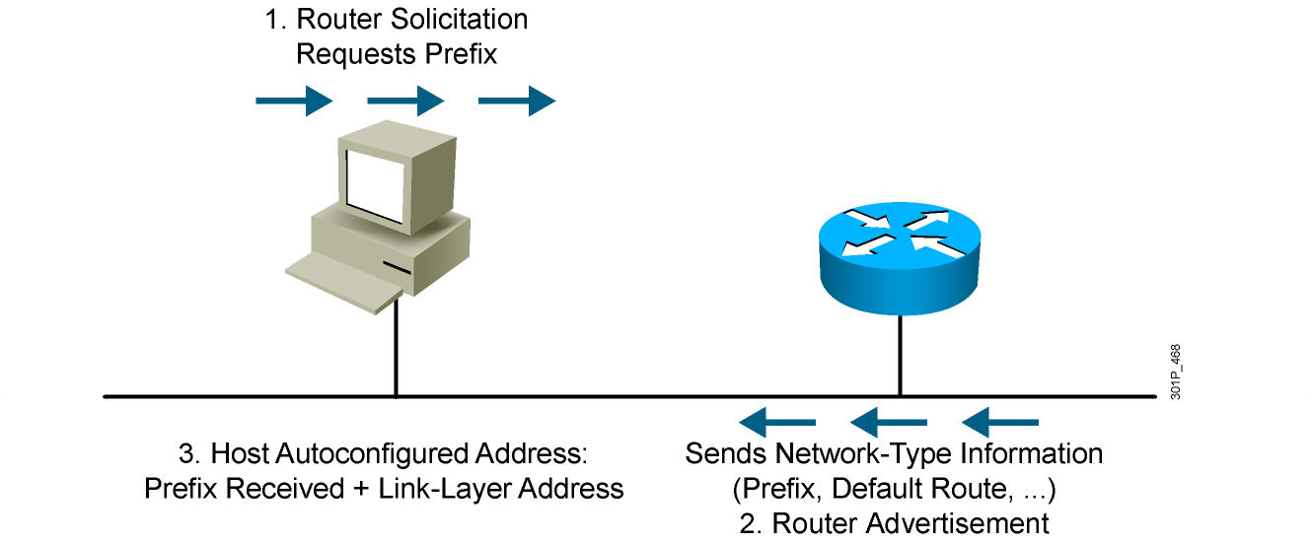
Stateless Autoconfiguration

Slide 14
DHCPv6 (Stateful)
DHCPv6 is an updated version of DHCP for IPv4:
  Supports new addressing
  Enables more control than stateless autoconfiguration
  Can be used for renumbering
  Can be used for automatic domain name registration of hosts using dynamic DNS
Notes:
DHCPv6 (Dynamic Host Configuration Protocol) is an updated version of DHCP for IPv4. It supports the addressing model of IPv6 and benefits from new IPv6 features. DHCPv6:
Enables more control than serverless/stateless auto-configuration.
Can be used in a routerless environment using only servers.
Can also be used concurrently with stateless auto-configuration.
Can be used for renumbering.
Can be used for automatic domain name registration of hosts using dynamic DNS.

Slide 15
DHCPv6 Operation
DHCPv6 operates in a way that is similar to DHCPv4, except:
  Client first detects the presence of routers on the link.
  If a router is found, the router advertisement is examined to determine if DHCP can be used.
  If no router is found, or if the router says DHCP can be used, then:
    A DHCP solicit message is sent to the all-DHCP-agents multicast address.
    The client uses the link-local address as the source address.
Notes:
The process for acquiring configuration data for a client is similar to that in IPv4, but with a few exceptions. Initially, the client must first detect the presence of routers on the link using Neighbor Discovery messages. If at least one router is found, then the client examines the router advertisements to determine if DHCP should be used. If the router advertisements enable use of DHCP on that link or if no router is found, then the client starts a DHCP Solicit phase to find a DHCP server.
DHCPv6 uses multicast for many messages. When the client sends a Solicit message, it sends the message to the ALL-DHCP-Agents multicast address with link-local scope. Agents include both servers and relays.
When a DHCP relay forwards a message, it can forward it to the All-DHCP-Servers multicast address with site-local scope. This means that a relay does not need to be configured with all the static addresses of the DHCP servers, as in IPv4. If needed by policy, a relay can contain a static list of DHCP servers.
Some servers can be configured to give global addresses using some policies (for example, more restrictive: do not give to printer…), while others (or the same within a different context) can be configured to give site-local addresses using a different policy (i.e. more liberal: give to anyone).

Slide 16
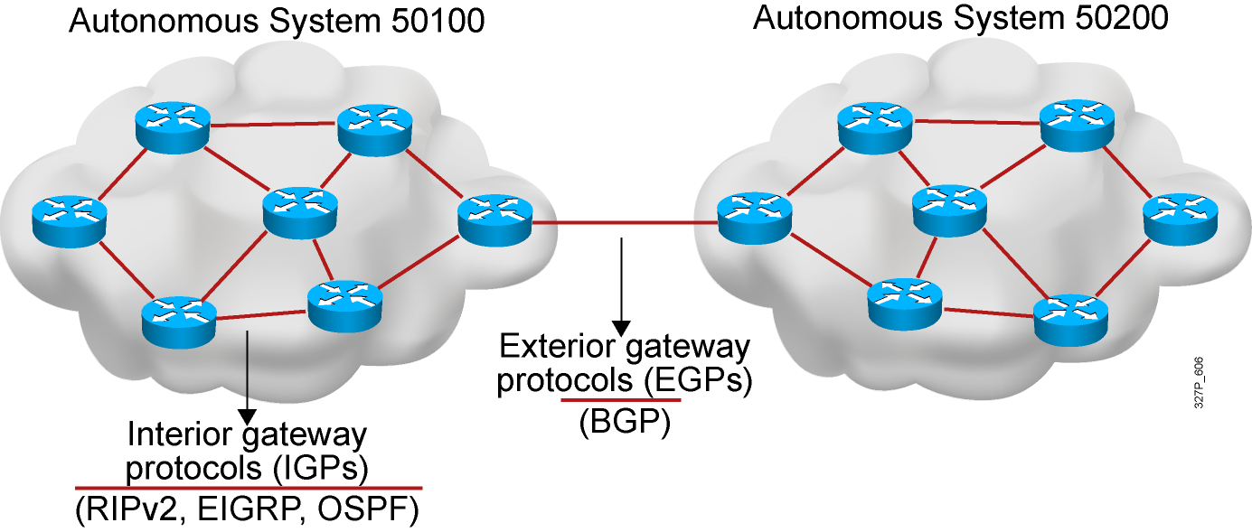
IPv6 Routing Protocols
  IPv6 routing types:
    Static
    RIPng (RFC 2080)
    OSPFv3 (RFC 2740)
    IS-IS for IPv6
    MP-BGP4 (RFC 2545/2858)
    EIGRP for IPv6
  The ipv6 unicast-routing command is required to enable
  IPv6 before any routing protocol is configured.

Slide 17
RIPng (RFC 2080)
Similar IPv4 features:
  Distance vector, radius of 15 hops, split horizon, and poison reverse
  Based on RIPv2
Updated features for IPv6:
  IPv6 prefix, next-hop IPv6 address
  Uses the multicast group FF02::9, the all-rip-routers multicast group, as the destination address for RIP updates
  Uses IPv6 for transport
  Named RIPng

Slide 18
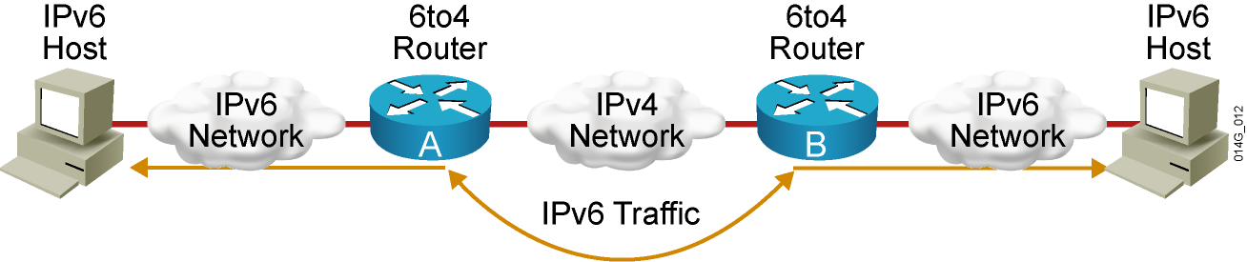
IPv4-to-IPv6 Transition
Transition richness means:
    No fixed day to convert; no need to convert all at once
    Different transition mechanisms are available:
      Dual stack
      Manual tunnel
      6to4 tunnel
      ISATAP tunnel
      Teredo tunnel
    Different compatibility mechanisms:
      Proxying and translation (NAT-PT)

Slide 19
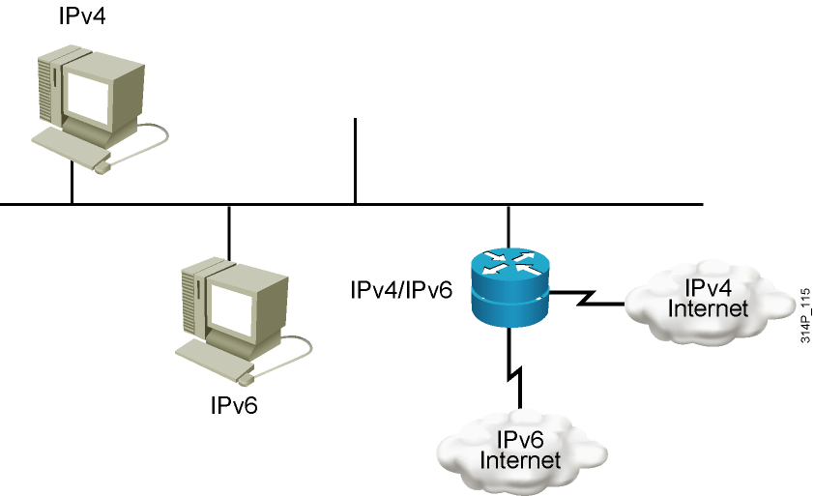
Cisco IOS Dual Stack
Dual stack is an integration method in which a node has implementation and connectivity to both an IPv4 and IPv6 network.

Slide 20
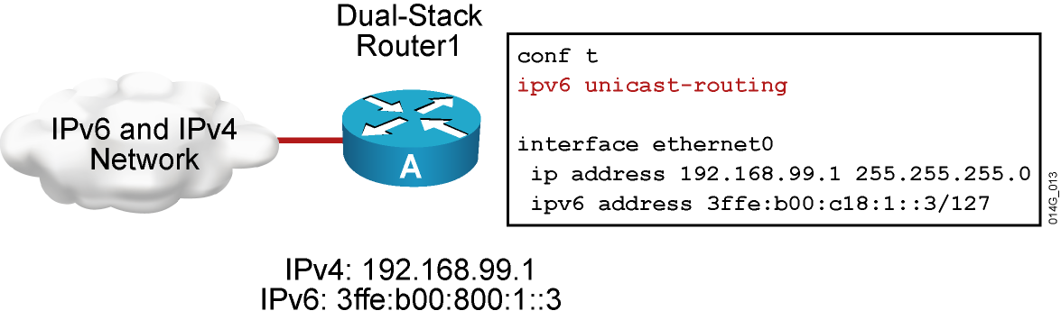
Cisco IOS Dual Stack (Cont.)
When both IPv4 and IPv6 are configured on an interface, the interface is considered dual-stacked.

Slide 21
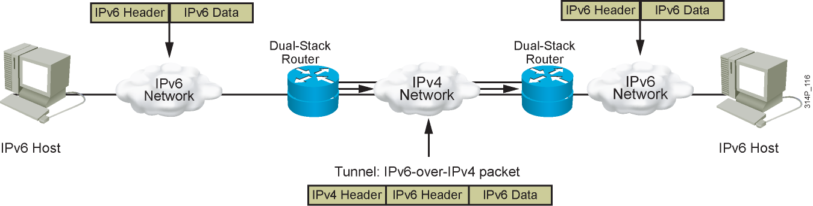
IPv6 Tunneling
Tunneling is an integration method in which an IPv6 packet is encapsulated within another protocol, such as IPv4. This method of encapsulation is IPv4.
  Includes a 20-byte IPv4 header with no options and an IPv6 header and payload
  Requires dual-stack routers

Slide 22
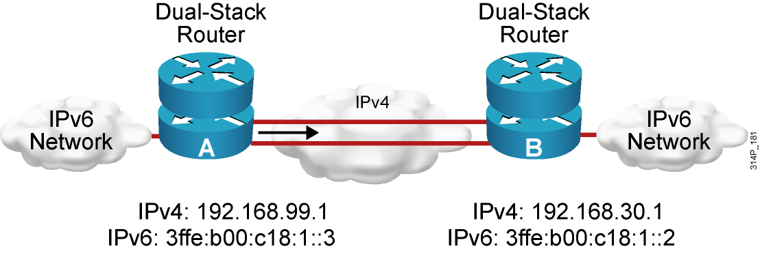
Manually Configured IPv6 Tunnel
Configured tunnels require:
  Dual-stack endpoints
  IPv4 and IPv6 addresses configured at each end

Slide 23
Enabling IPv6 on Cisco Routers
RouterX(config)#
ipv6 unicast-routing
Enables IPv6 traffic forwarding
RouterX(config-if)#
ipv6 address ipv6prefix/prefix-length eui-64
Configures the interface IPv6 addresses
Notes:
There are two basic steps to activate IPv6 on a router. First, IPv6 traffic forwarding must be activated, then each interface where IPv6 is required must be configured.
By default, IPv6 traffic forwarding is disabled on a Cisco router. To activate IPv6 traffic forwarding between interfaces, the global command ipv6 unicast-routing must be configured. This enables the forwarding of unicast IPv6 traffic.
IPv6 is enabled on a per interface basis.
Configuring an IPv6 address on an interface automatically configures the interface link-local address and activates IPv6 for that interface.

Slide 24
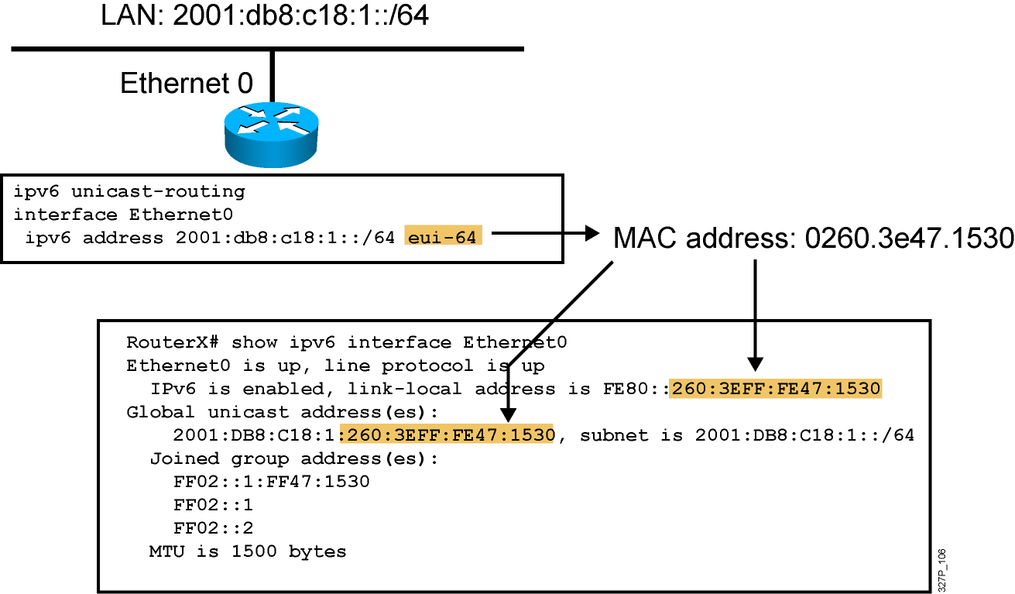
IPv6 Address Configuration Example
Notes:
240, 197, 102
The configuration of the IPv6 address on an interface automatically configures the link-local address for that interface. Also, the interface automatically joins the required multicast groups for that link:
Solicited node multicast address FF02::1:FF47:1530
All hosts on the link multicast addresses FF02::1
All routers on the link multicast addresses FF02::2
The solicited node multicast address is used in the duplicate address detection algorithm and neighbor discovery.
A solicited node multicast address is joined for each IPv6 unicast and anycast address configured on the interface.

Slide 25
Cisco IOS IPv6 Name Resolution
Two ways to perform Cisco IOS name resolution for IPv6:
Define a static name for IPv6 addresses
RouterX(config)#
ipv6 host name [port] ipv6addr [{ipv6addr} ...]
RouterX(config)# ipv6 host router1 3ffe:b00:ffff:b::1
Configure a DNS server or servers to query
RouterX(config)#
ip name-server address
RouterX(config)#ip name-server 3ffe:b00:ffff:1::10
Notes:
It is possible to define static name for IPv6 addresses using the command ipv6 host <name>. Up to 4 IPv6 addresses can be defined for one hostname. The “port” field is the default telnet for the associated host.
To specify the DNS server used by the router, use the ip name-server <address> command. The <address> can be an IPv4 or IPv6 address. Several DNS servers can be specified with this command – up to 6.

Slide 26
Configuring and Verifying RIPng for IPv6
RouterX(config)#
ipv6 router rip tag
Creates and enters RIP router configuration mode
RouterX(config-if)#
ipv6 rip tag enable
Configures RIP on an interface
show ipv6 rip
Displays the status of the various RIP processes
show ipv6 route rip
Shows RIP routes in the IPv6 route table
Notes:
This is a sample of the syntax of some commonly used commands. The syntax is similar, if not identical, to their IPv4 counterparts.
Enabling RIP on an interface will dynamically create a « router rip » process if necessary

Slide 27
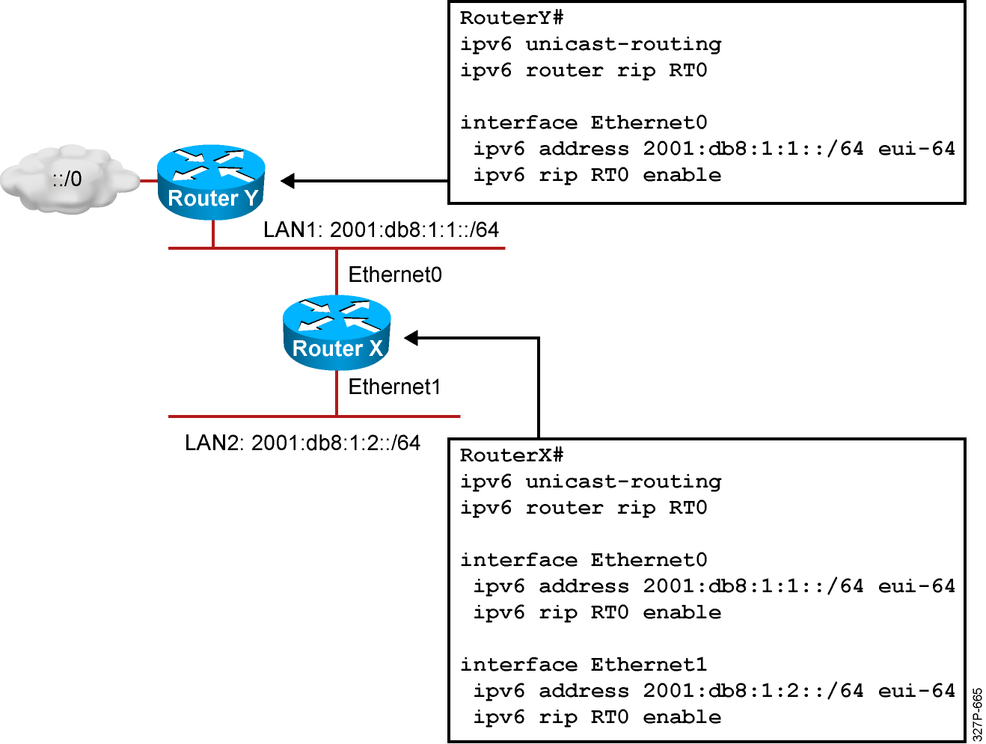
RIPng for IPv6 Configuration Example
Notes:
The example shows a two router portion of a larger network. The lower router is connected to two internal LANs. The screen text is from the lower router, called Router1. It shows that RIP is enabled on both Ethernet interfaces (ipv6 rip RT0 enable).

Slide 28
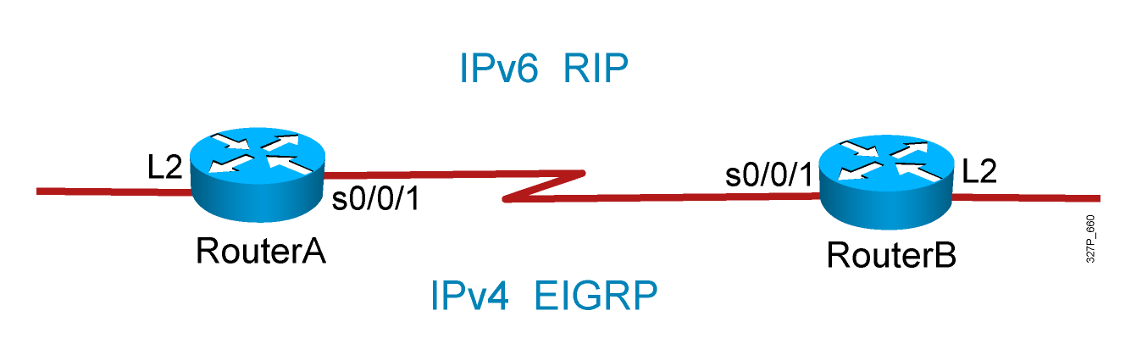
Visual Objective 7-2: Implementing IPv6
Notes:
Lab 13 ACL
Note: Refer to the lab setup guide for lab instructions.

Slide 29
Summary
  IPv6 offers many additional benefits to IPv4 including a larger address space, easier address aggregation, and integrated security.
  The IPv6 address is 128 bits long and is made up of a 48-bit global prefix, a 16-bit subnet ID, and a 64-bit interface identifier.
  There are several ways to assign IPv6 addresses: statically, stateless autoconfiguration, and DHCPv6.
  Cisco supports all of the major IPv6 routing protocols: RIPng, OSPFv3, and EIGRP.
  Transitioning from IPv4 to IPv6 requires dual stacks, tunneling, and possibly NAT-PT.
  Use the ipv6 unicast-routing command to enable IPv6 and the ipv6 address ipv6-address/prefix-length command to assign interface addresses and enable an IPv6 routing protocol.

